Slide 1
APACHE poi with Selenium Automation Testing

Slide 2
Objectives
Develop skills in formulating test cases using Boundary value technique.
To get familiar with Automation testing using Selenium WebDriver and Apache POI.

Slide 3
Automation Testing with Selenium
Selenium WebDriver:
Open-source suite of tools for automating web browsers
Supports multiple programming languages (Java, Python, C#, Ruby, etc.)
Can control various web browsers (Chrome, Firefox, Safari, Edge, etc.)
Provides a platform-independent way to write tests
Test Execution:
Launched the desired web browser instance
Located web elements (input fields, buttons, etc.) using locator strategies
Performed actions on web elements (click, send keys, etc.)
Executed test cases and captured results (pass/fail)
Utilized assertion statements to verify expected behaviors

Slide 4
APACHE POI
Apache POI is an open-source java library to create and manipulate various file formats based on Microsoft Office
Apache POI provides stream-based processing, that is suitable for large files and requires less memory
Apache POI is able to handle both XLS and XLSX formats of spreadsheets.

Slide 5
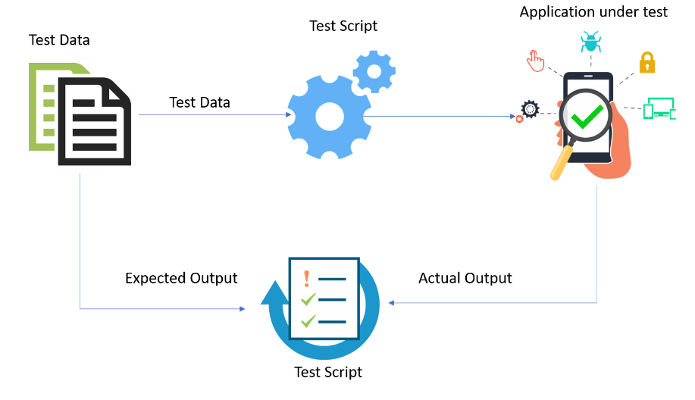

Slide 6
Methodology
Website Selected: IRCTC Next Generation eTicketing System
Input Fields Chosen:
From
To
Date
Boundary Values:
From/To:
First valid station code (e.g., "A*")
Last valid station code (e.g., "Z*“)
Date:
Earliest valid future date
Latest valid future date
One day before the earliest date
One day after latest valid future date

Slide 7
Tests/Code and Results

